Slide 1

Exam AI-100: Designing and Implementing an Azure AI Solution Crash Course
Tim Warner

Slide 2


Tim Warner
Based in Nashville, TN, US
MCT, MVP
Twitter: @TechTrainerTim
Badge: timw.info

Slide 3
Course Materials
timw.info/ai100

Slide 4
Session 1 of 2 Learning Goals
Introduction
Fundamental Terminology
Azure AI Technology Stack Overview
Azure Machine Learning
Azure Cognitive Services

Slide 5
Session 2 of 2 Learning Goals
Azure Bot Service
Creating and Deploying Bots
Monitoring Azure AI Solutions
AI-100 Exam Strategy

Slide 6
Setting Expectations
This is a "crash course"
Plan to review these materials more than once
Five-minute break at midpoint
Please ask/answer questions and provide feedback in the Q/A panel, not the group chat

Slide 7
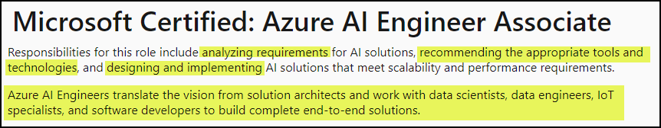
The Microsoft AI Engineer
https://timw.info/dc2ac

Slide 8
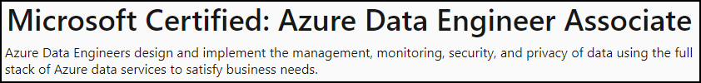
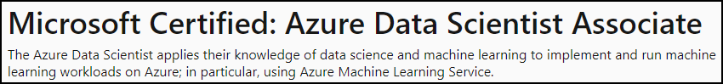
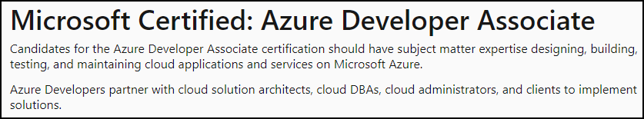
Other Microsoft AI Job Roles

Slide 9
Tim's Certification Study Pyramid
Interdependence
Content knowledge
Practical application
Test-taking skills

Slide 10
Fundamental Terminology

Slide 11
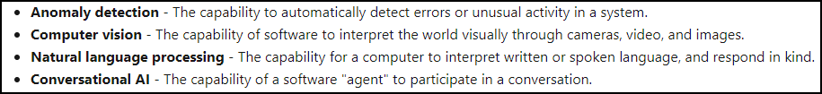
Artificial Intelligence (AI)
Any technique that enables computers to mimic human intelligence
https://timw.info/2bdb4

Slide 12
Machine Learning (ML)
Subset of AI that includes techniques that enable machines to improve at tasks with experience.
Supervised
Regression (prediction)
Classification
Unsupervised
Clustering

Slide 13
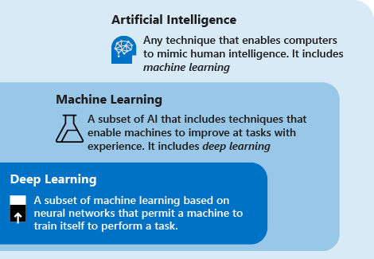
AI Schema
https://timw.info/c7769

Slide 14
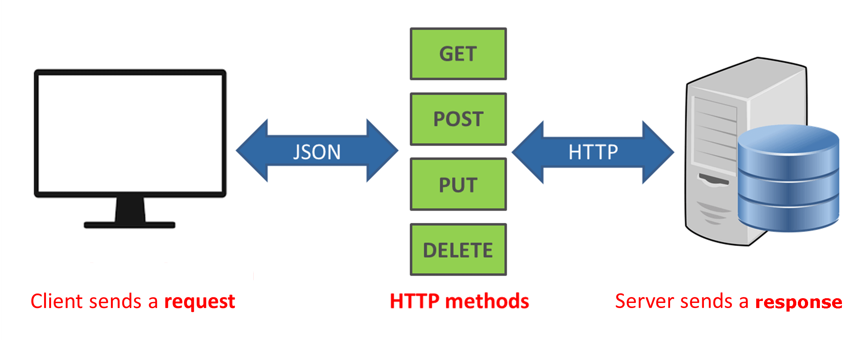
How a REST API Works
CRUD
https://timw.info/a850d

Slide 15
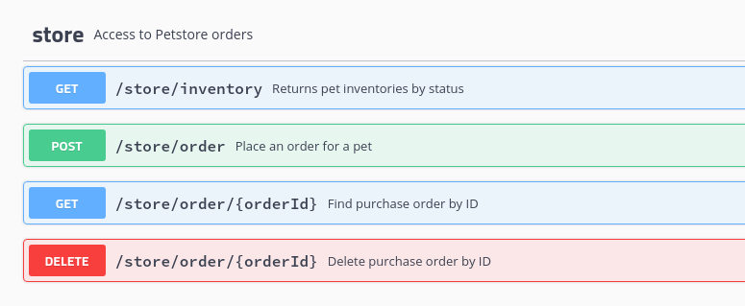
HTTP Methods
https://timw.info/cc6b1

Slide 16

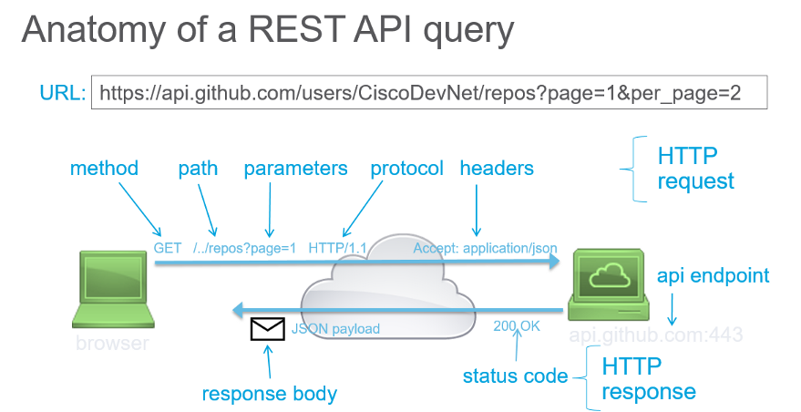
How a REST API Works
https://timw.info/d7a91

Slide 17
Azure AI Technology Stack Overview

Slide 18
Azure AI Stack
Apache Spark on Azure (MMLSpark)
HDInsight
Databricks
Azure Machine Learning
Azure Cognitive Services
Azure Cognitive Search
Azure Bot Service

Slide 19
Azure Cognitive Services
* Vision
* Computer Vision
* Face
* Video Indexer
* Speech
* Speech to Text
* Speaker Recognition
* Speech Translation

Slide 20
Azure Cognitive Services
* Language
* Text Analytics
* LUIS
* Decision
* Content Moderator
* Search
* Bing Search
* Bing Statistics

Slide 21
Azure AI Related Services

Slide 22
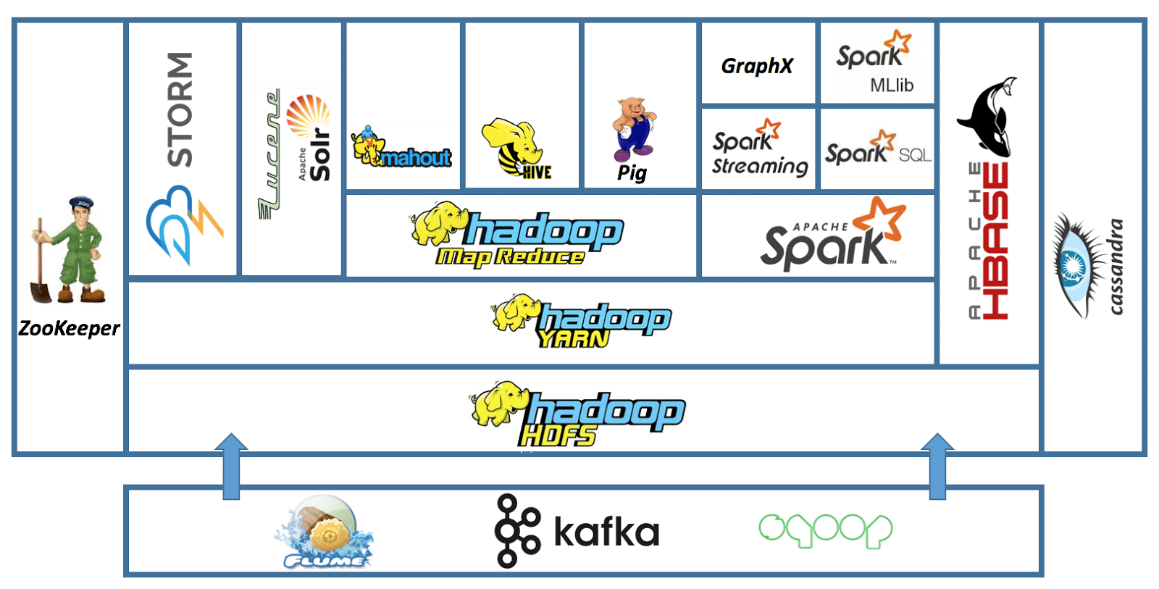
Apache Hadoop
Event Hub
HDInsight
Service Bus
https://timw.info/7f992

Slide 23
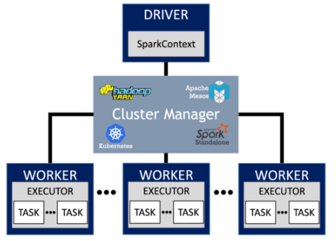
Apache Spark
https://timw.info/7e4a3

Slide 24
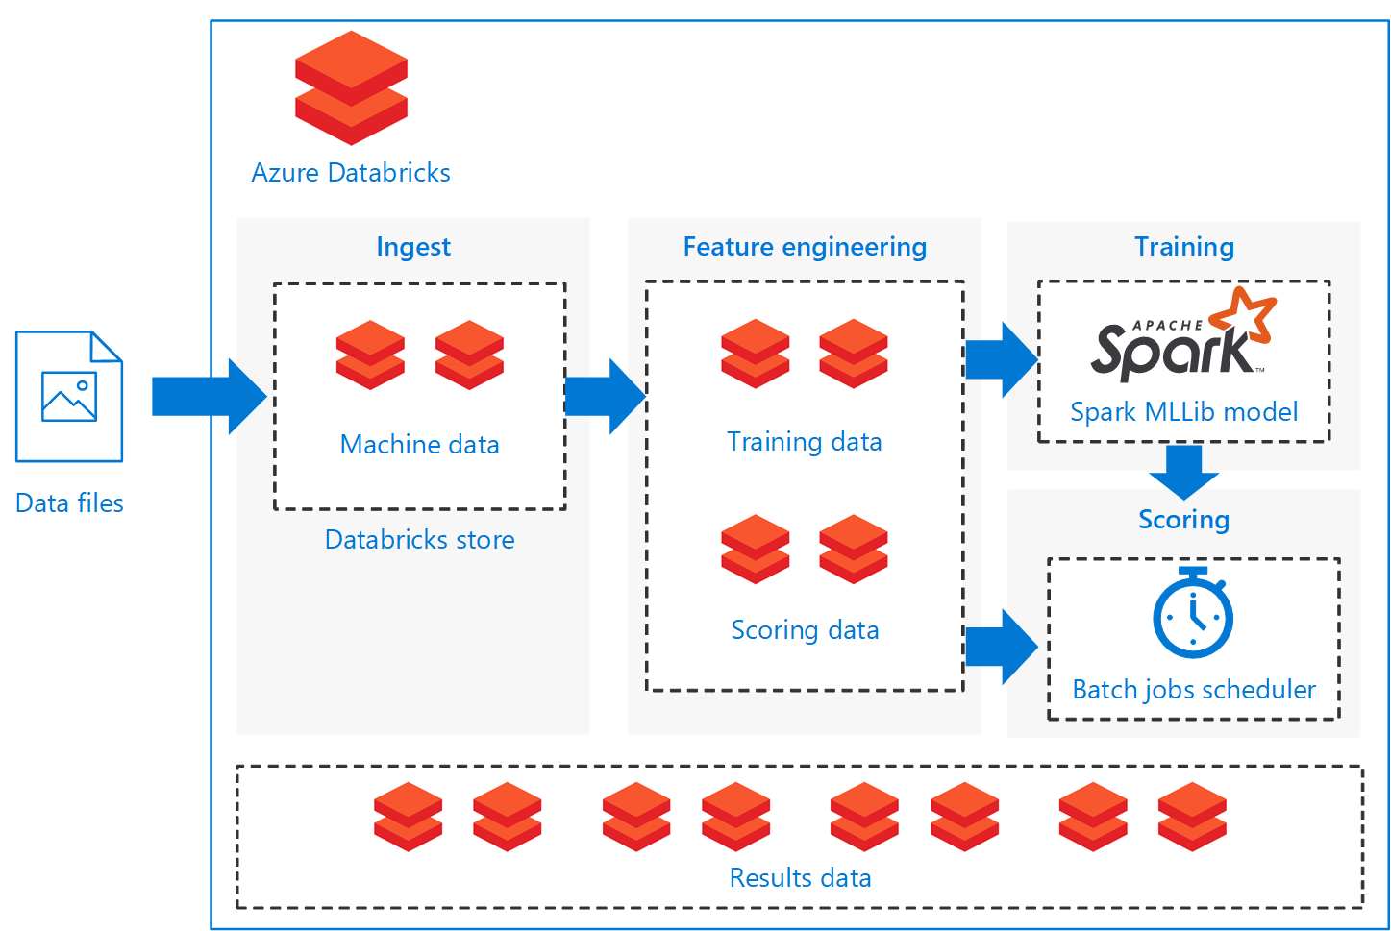
Databricks
https://timw.info/a9ab9

Slide 25
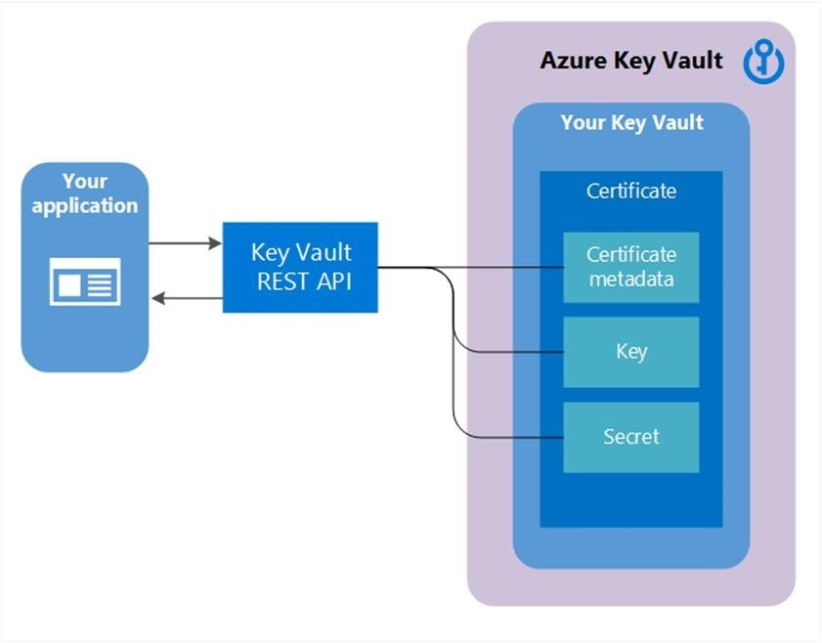
Azure Key Vault
Soft delete
Purge protection
https://timw.info/22bfc

Slide 26
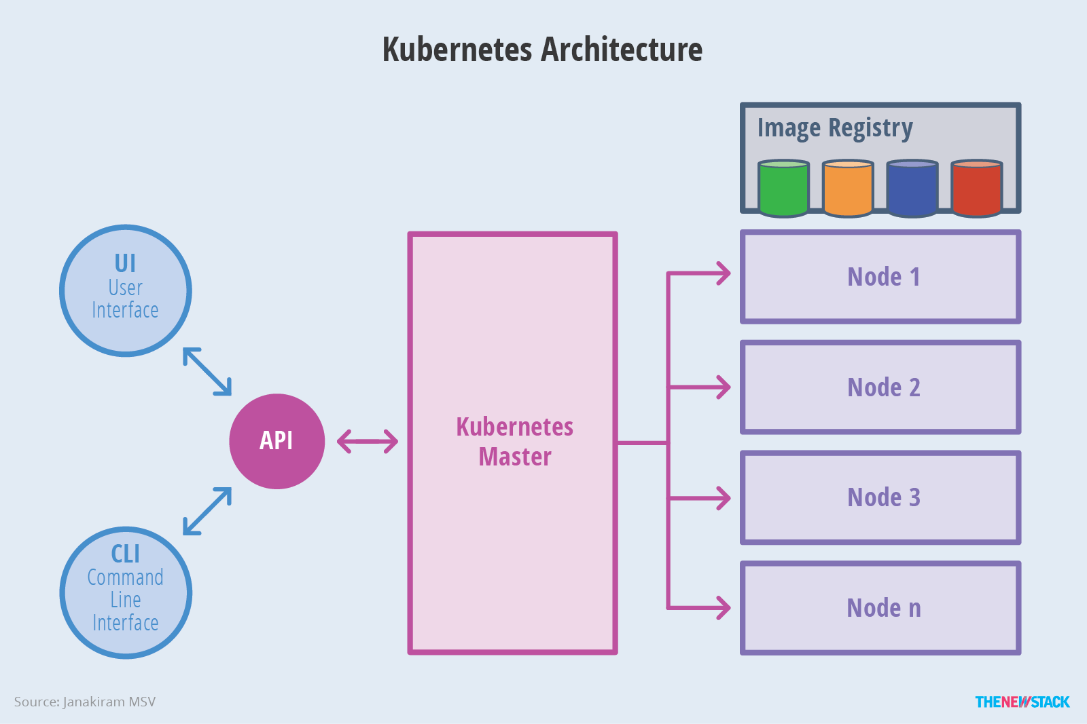

Azure Kubernetes Service (AKS)
SSH
Azure CLI
kubectl
https://timw.info/f888f

Slide 27
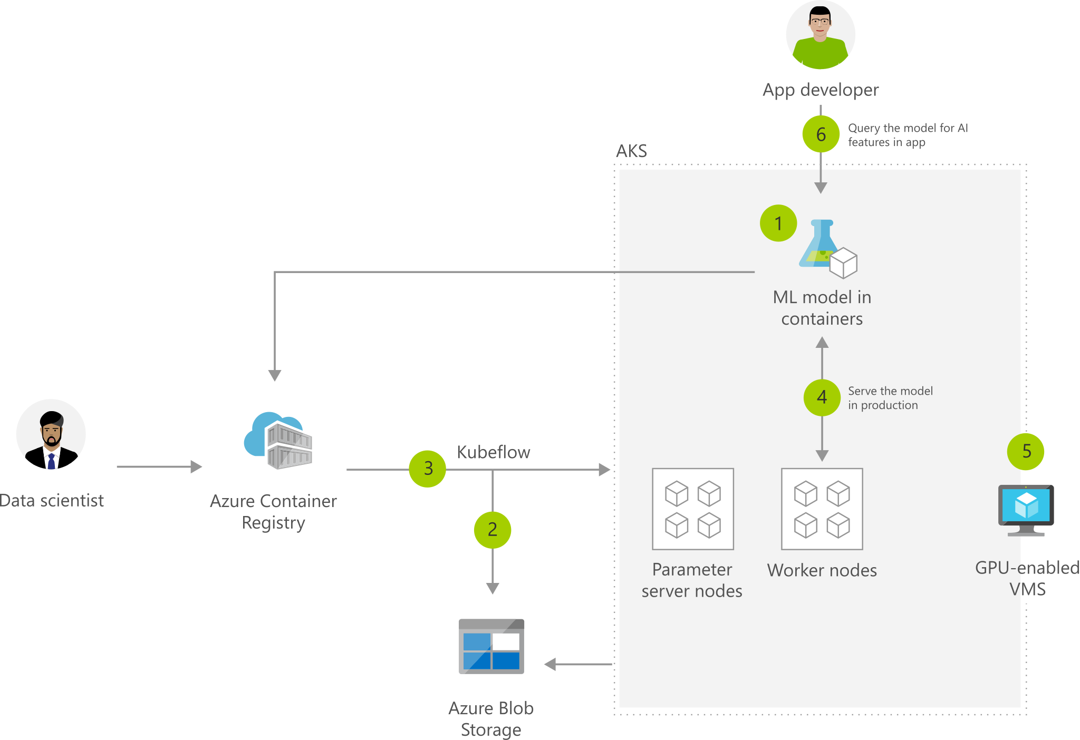
Machine Learning with AKS
https://timw.info/2b505

Slide 28
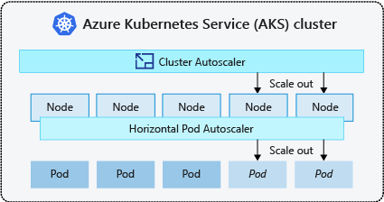
AKS Scaling
https://timw.info/1c670

Slide 29
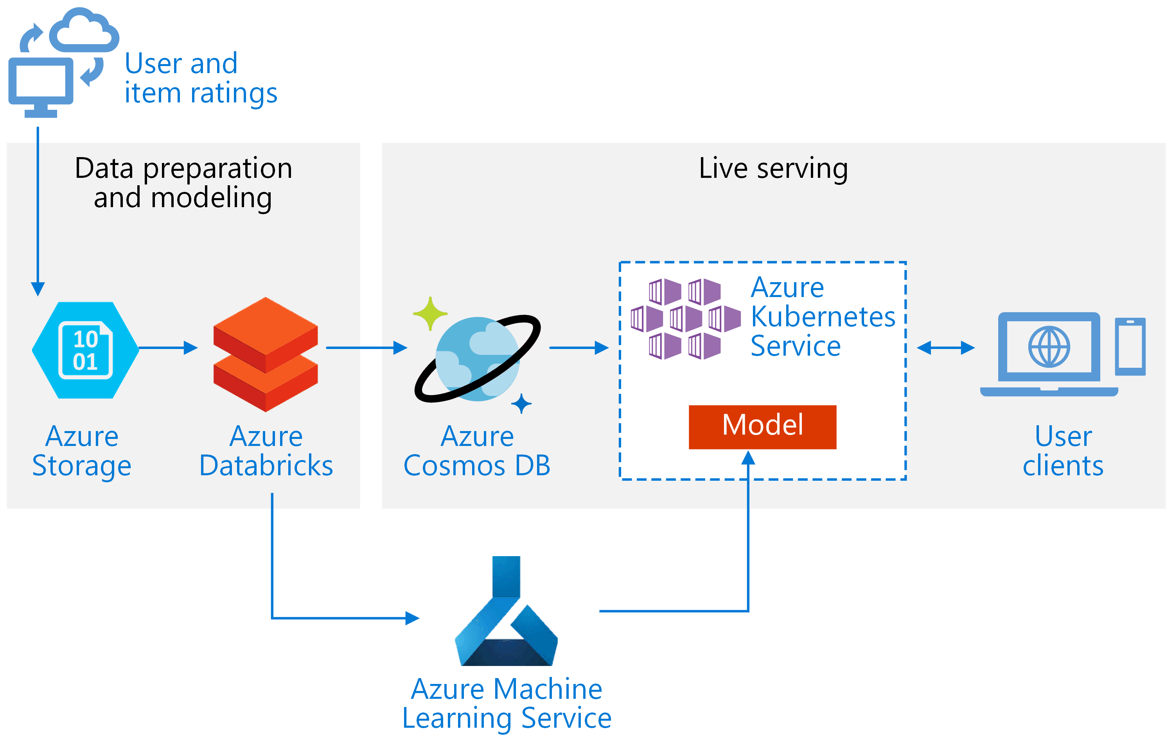
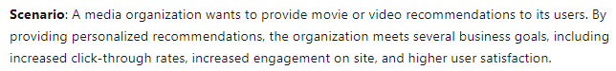
Real-Time Recommendation API
https://timw.info/e25e0

Slide 30
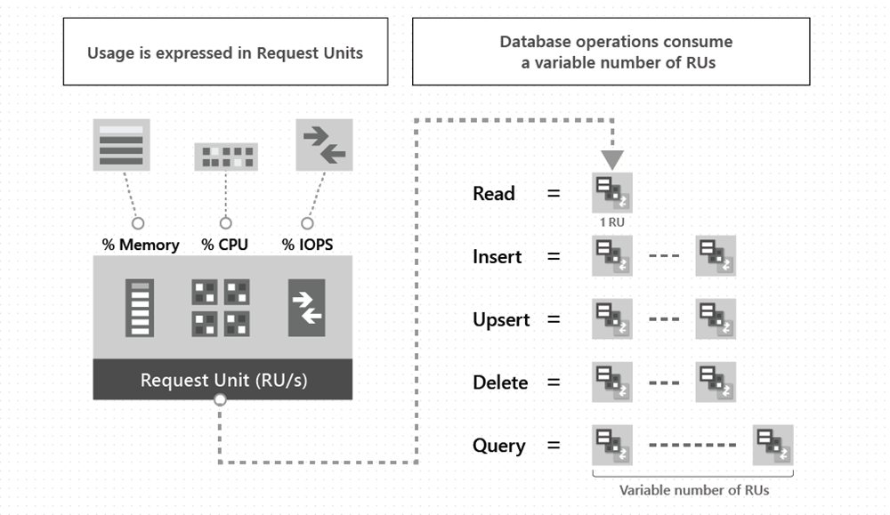
Cosmos DB Request Units
https://timw.info/65a44

Slide 31
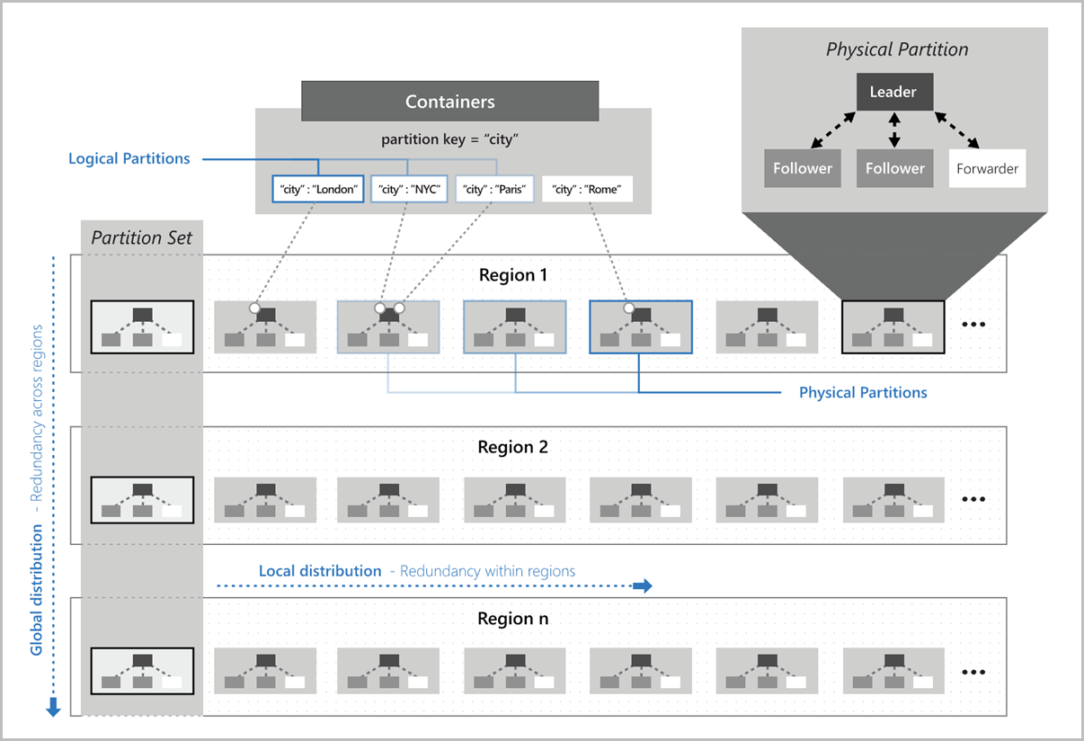
Cosmos DB Partitioning
https://timw.info/2c1f8

Slide 32
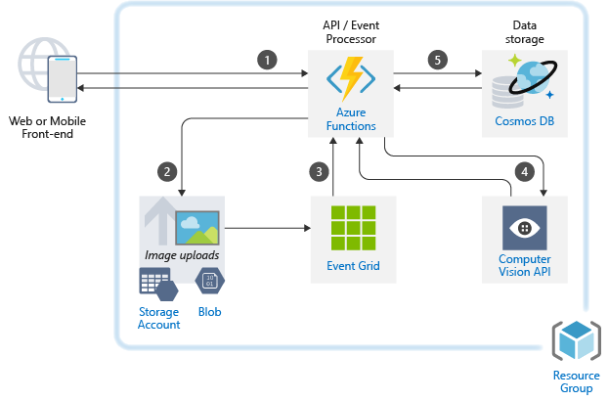
Use Case: Image Classification
https://timw.info/caa25

Slide 33
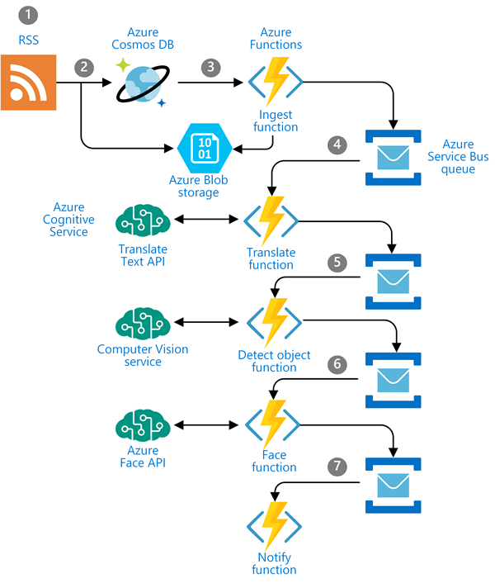
Use Case: Newsfeed Ingestion
https://timw.info/c0015

Slide 34
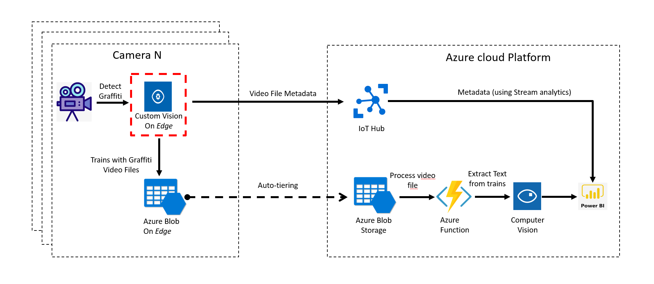
Use Case: IoT
https://timw.info/3f2c0

Slide 35
Azure Machine Learning

Slide 36
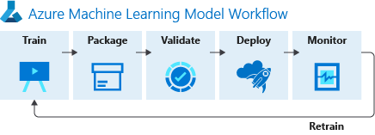
ML Workflow
https://timw.info/f82d3

Slide 37
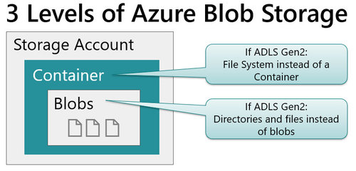
Blob Storage and Data Lake Storage
CSV, JSON
https://timw.info/772f8

Slide 38
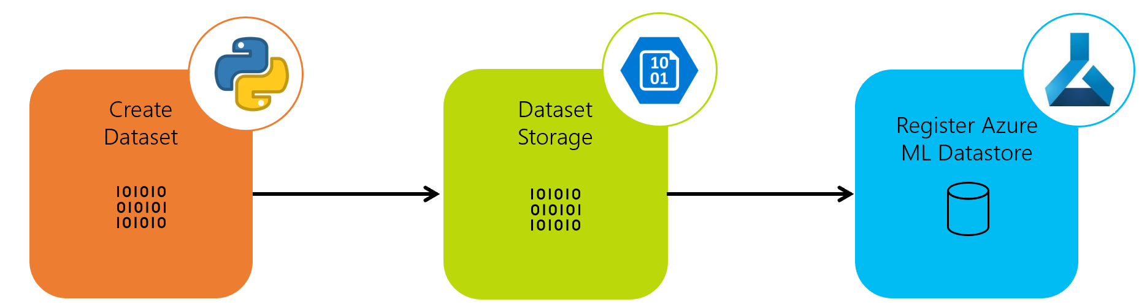
Azure ML Dataset & Datastore
https://timw.info/a1df2

Slide 39
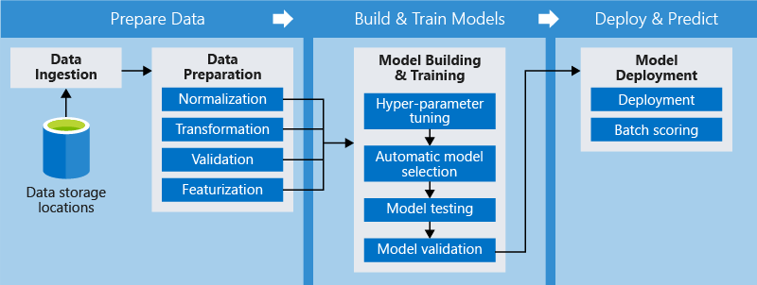
Azure ML Pipeline
https://timw.info/d572e

Slide 40
Azure Cognitive Services

Slide 41
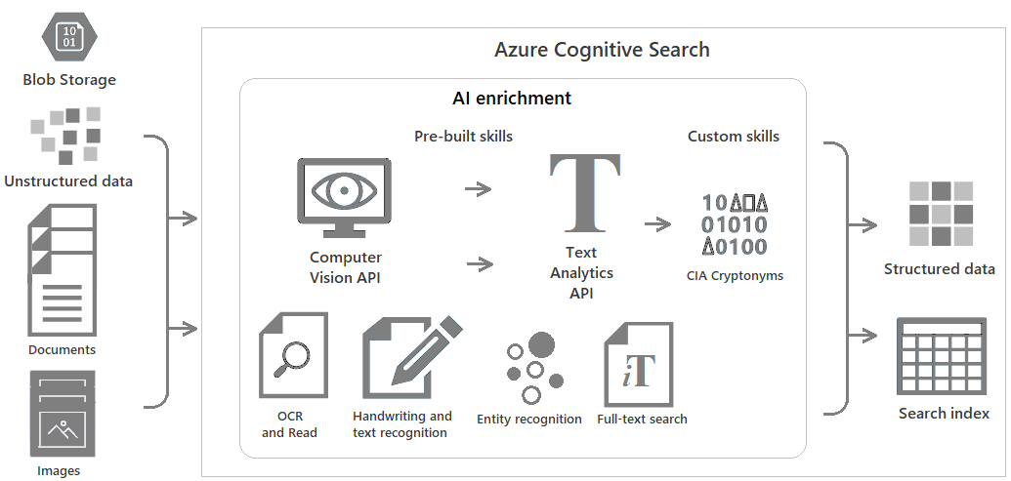
Azure Cognitive Search
https://timw.info/c6ab1

Slide 42
Azure Bot Service

Slide 43
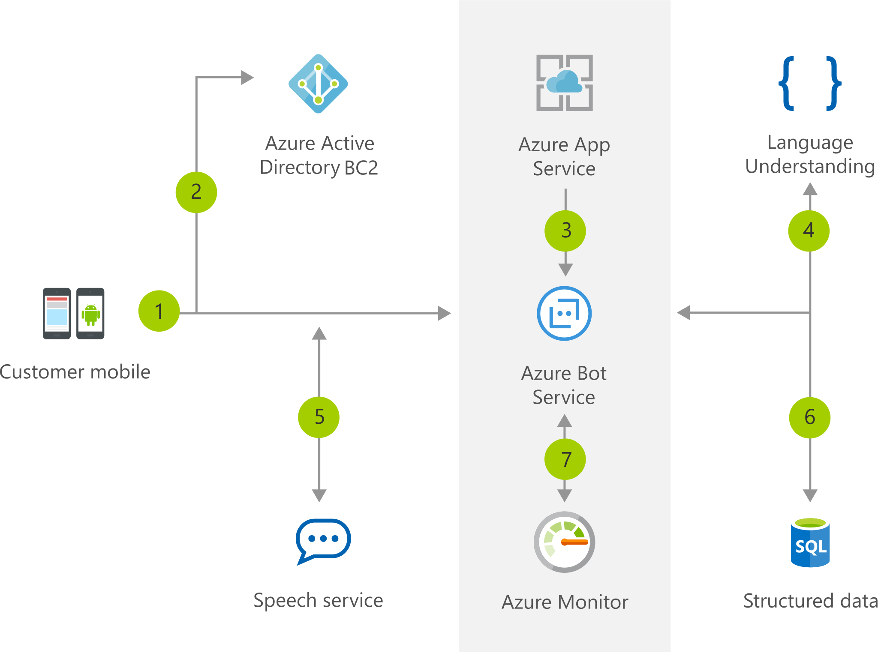
Chatbot
https://timw.info/b04eb

Slide 44
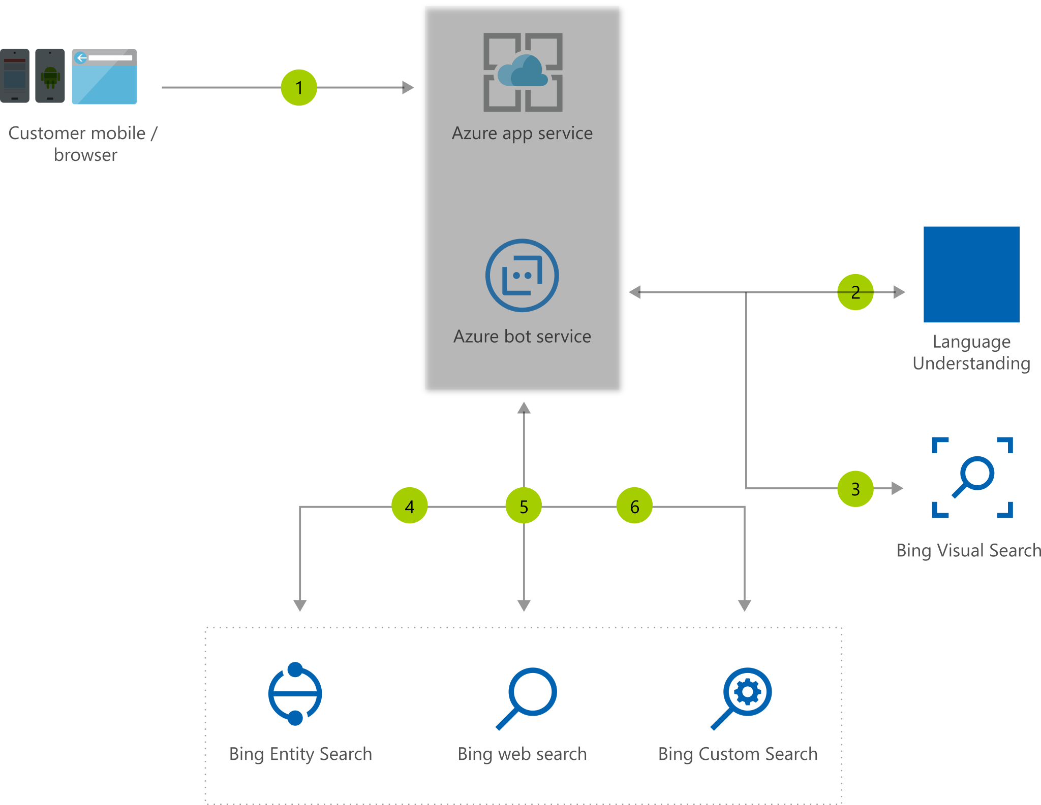
Visual Assistant
https://timw.info/380d7

Slide 45
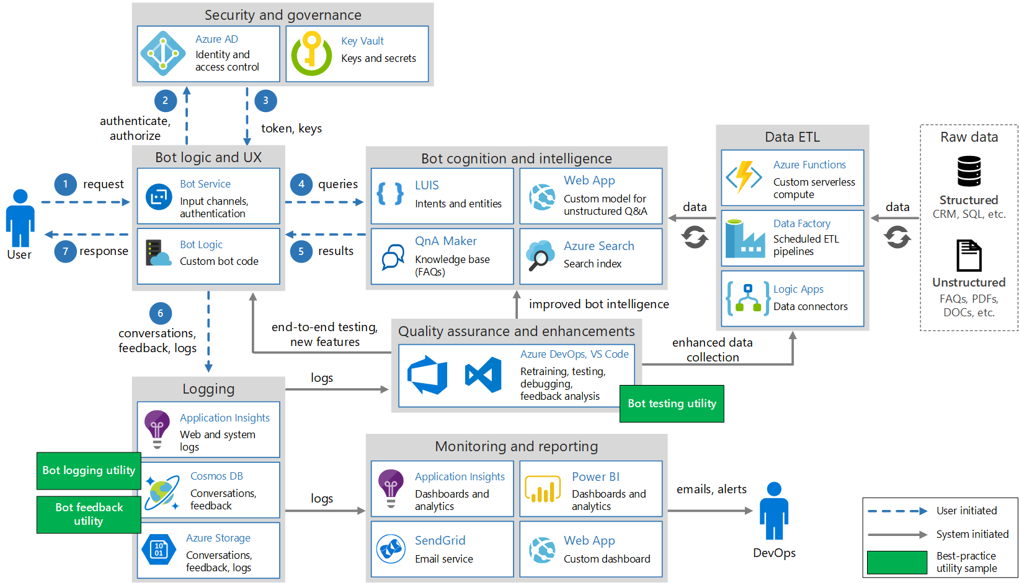
Conversational Bot
https://timw.info/32e9e

Slide 46
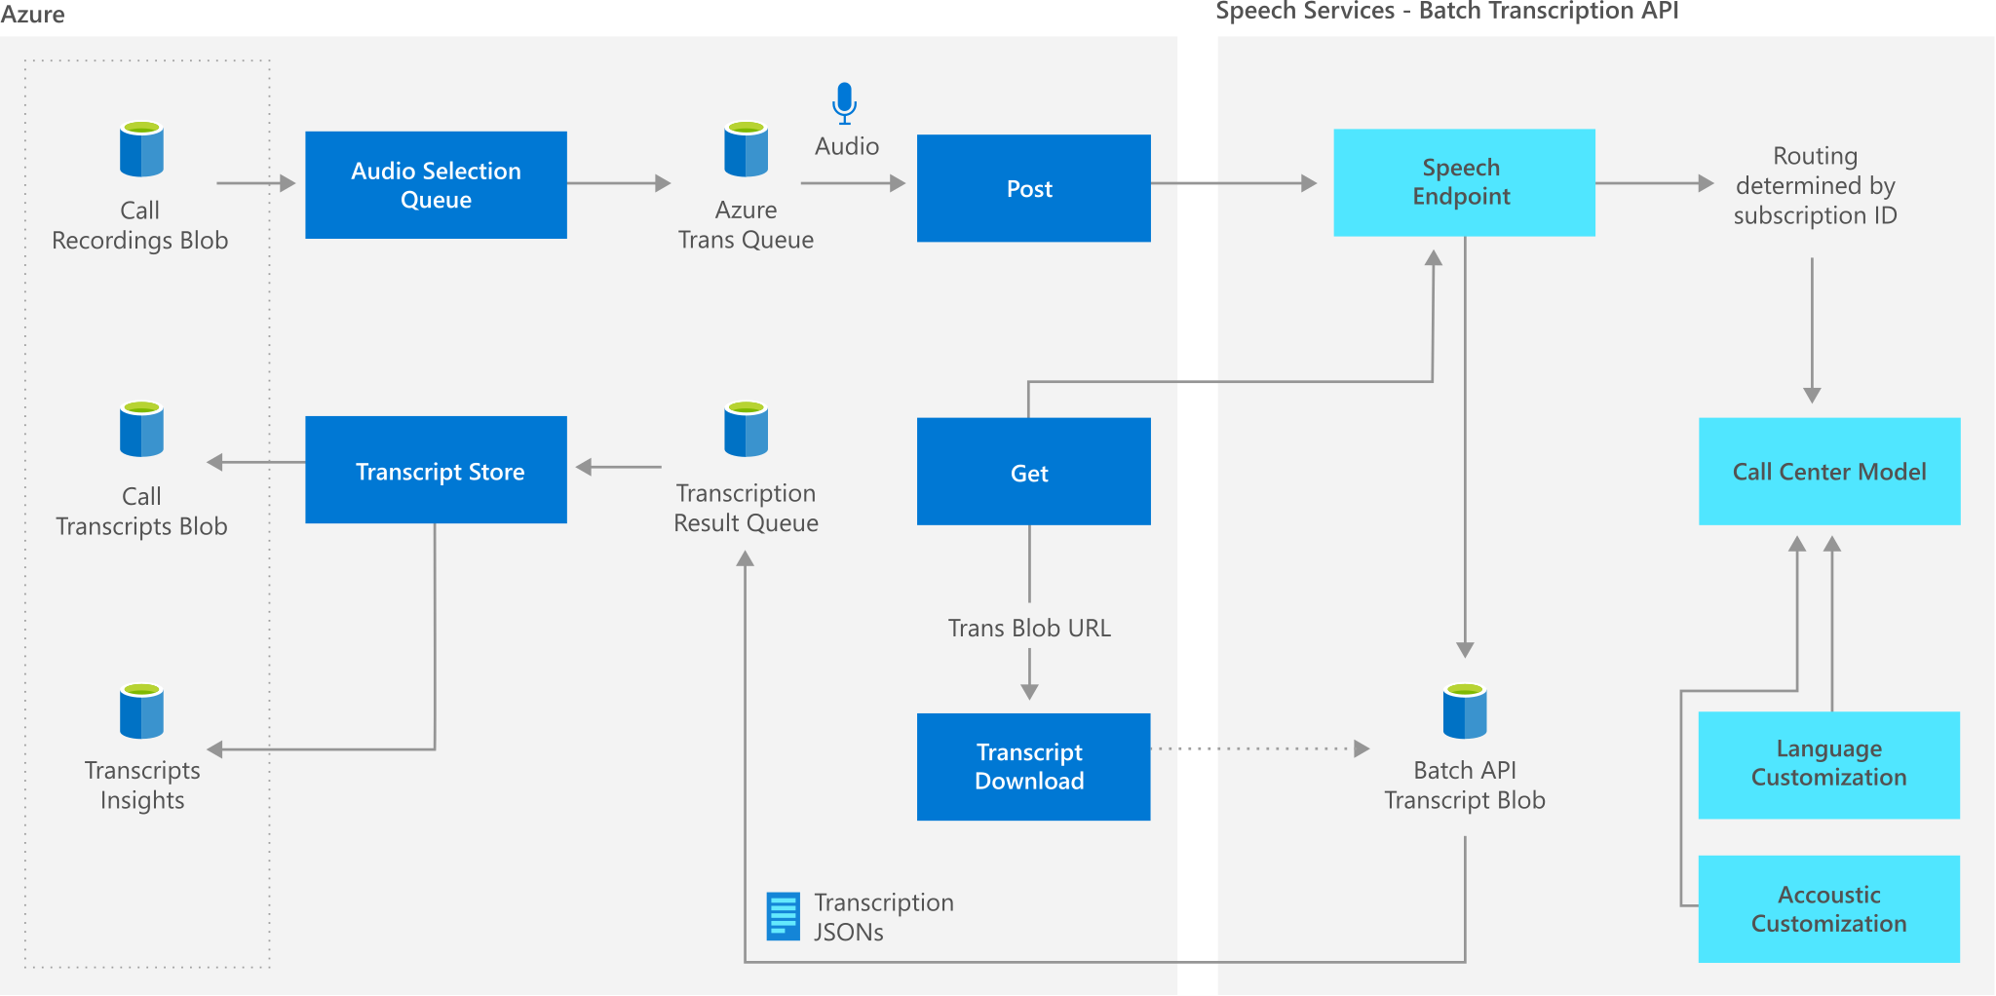
Speech Services
https://timw.info/9b1bc

Slide 47
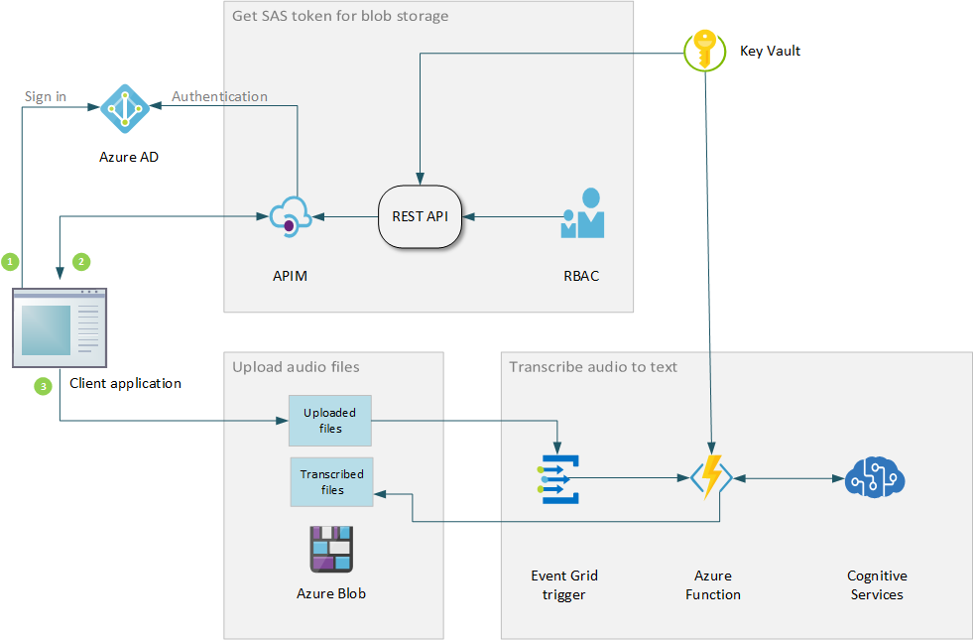
Speech Transcription
https://timw.info/59036

Slide 48
Exam AI-100 Strategy

Slide 49
Tim's Certification Study Pyramid
Interdependence
Content knowledge
Practical application
Test-taking skills

Slide 50
Item Types

Slide 51

Single Answer Multiple Choice

Slide 52

Multiple Answer Multiple Choice

Slide 53
Repeated Scenario
You need to move an Azure VM to another hardware host.
Solution: You redeploy the VM.
Does this solution meet the goal?
Yes
No

Slide 54
Repeated Scenario
You need to move an Azure VM to another hardware host.
Solution: You enable boot diagnostics.
Does this solution meet the goal?
Yes
No

Slide 55

Select and Place

Slide 56

Build List and Reorder

Slide 57

Active Screen/Fill in the Blank

Slide 58

Case Study

Slide 59






Performance-Based Lab

Slide 60
Microsoft Online Testing

Slide 61
Tim's Online Testing Video (YouTube)
timw.info/online

Slide 62

Microsoft Online Testing Process

Slide 63

Microsoft Online Testing Process

Slide 64

Microsoft Online Testing Process

Slide 65

Microsoft Online Testing Process

Slide 66

Microsoft Online Testing Process

Slide 67

Microsoft Online Testing Process

Slide 68

Microsoft Online Testing Process

Slide 69
Thank you!
Course materials: timw.info/ai100
Twitter: @TechTrainerTim
Work: timw.info/ps
Web: timw.info

